Slide 1
Circuit Box IDE
Circuit Draw Field
Component list
Measuring instruments
Utilities

Slide 2
Connectivity
Central
Lab server
Event handler
Users
Connecting
Hardware
Lab masters

Slide 3
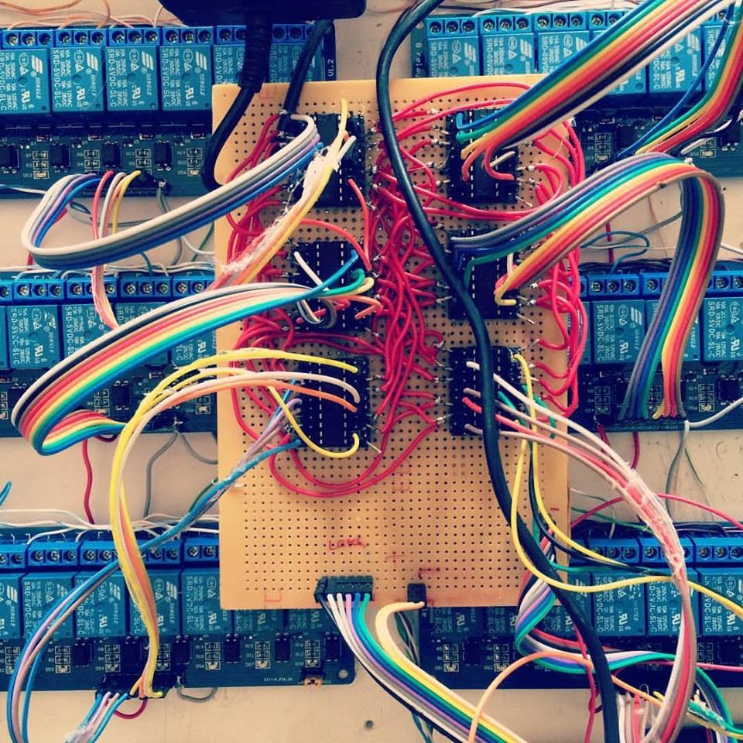

Slide 4
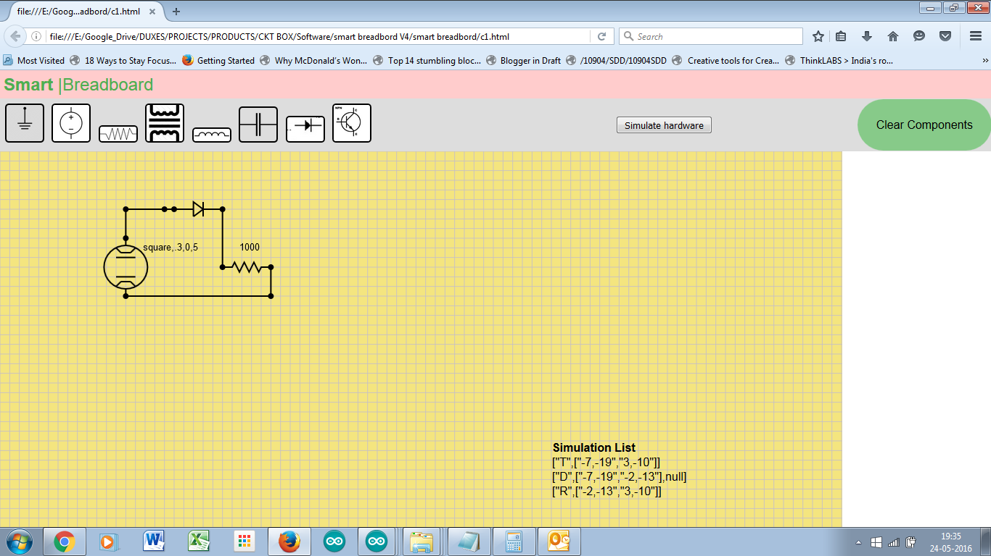
Simulation List ["T",["-7,-19","3,-10"]] ["D",["-7,-19","-2,-13"],null] ["R",["-2,-13","3,-10"]]

